Slide 1
Ambulatory ECG monitoring—Basics
Dr Muzammil Musthafa
Senior Resident,Cardiology
Govt Med College,Calicut

Slide 2
Palpitations is one of the MC problems—seen in day to day practice
Although it has varied etiologies, cardiac cause may be life-threatening
Establishing cause is usually difficult—as historical clues are mostly inaccurate
Usually point of time ECG is the first investigation, which in most cases will be non contributory, so the role for continuous ECG monitoring comes in place

Slide 3
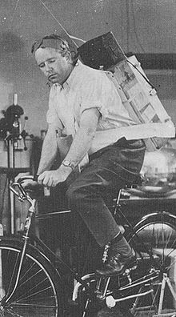
Norman Jeff Holter—American biophysicist and Gengerelli
Invented Holter monitor—1949
Portable device for continuously monitoring the electrical activity of heart

Slide 4
Advancement of technology—size of recorders reduced
In both weight and volume
<50g

Slide 6
Holter monitor
ELR
Event recorders
ILR
MCOT (mobile cardiac outpatient telemetry)
Smart watches

Slide 7
Holter recorders are continuos ECG recorders which digitally records(solid state recording) for 24—48 hrs
Computers scan the recording with snap shot recording of symptomatic events and other important finding
Of 25—50% of patients experience a complaint during recording, in 2—15% of cases, the complaint is caused by arrythmia

Slide 8
Holter
24—48 hrs
Multiple leads connected—3,5 or 7
Colour coded
Attached to bony prominences—To avoid movement artefacts
Usually Multichannel acquisition—3 channel

Slide 10
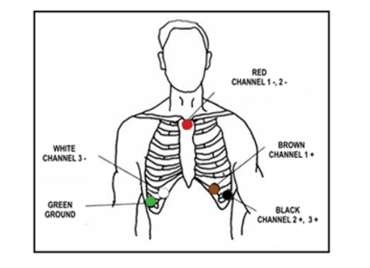

Slide 11
External loop recorders—electrodes connected by wires to monitor devices
Records for a longer duration of time—30 days
Observes continuously but records only selected events
Multichannel or single channel acquisition
Symptom event——patient triggered –usually post events
Autotriggered –pre,during and post events
Backward memory ++
Looping memory++

Slide 13
Implantable loop recorders—prolonged recordings
For very infrequent events—3yrs
Minor surgical procedure
Single channel—difficult to differentiate arrythmias
Oversensing –may exhaust the memory
Cost of device

Slide 14
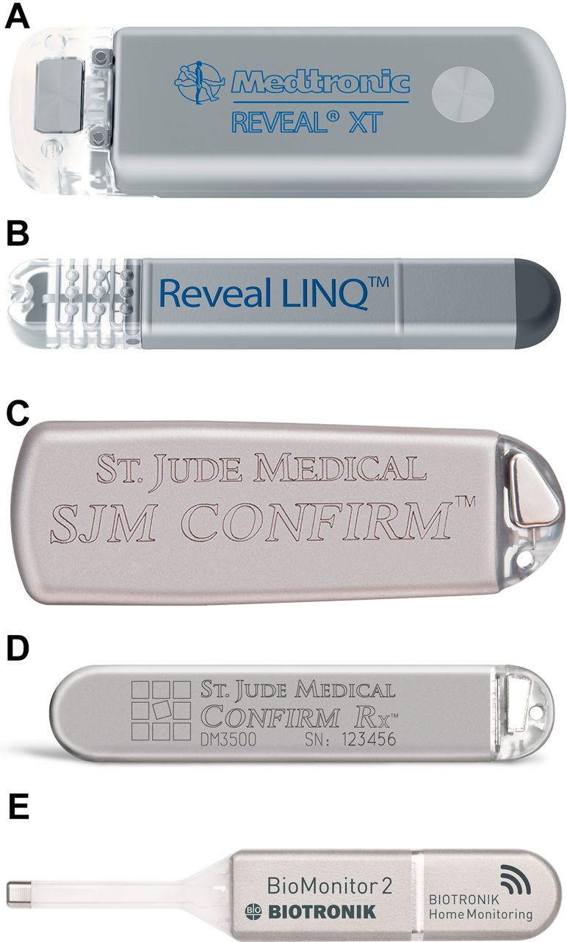

Slide 15
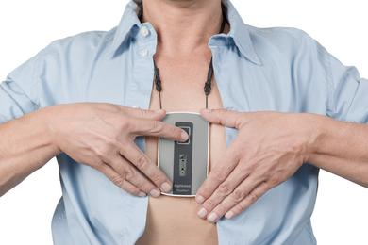
Event recorders—leadless recorders, held on to chest, real time transmission possible
Real time transmission ++
Single channel
Upto 30 days

Slide 16
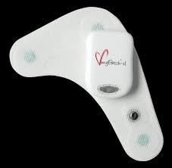
Patch recorders
Single channel
2—4 wks
Full disclosure

Slide 17
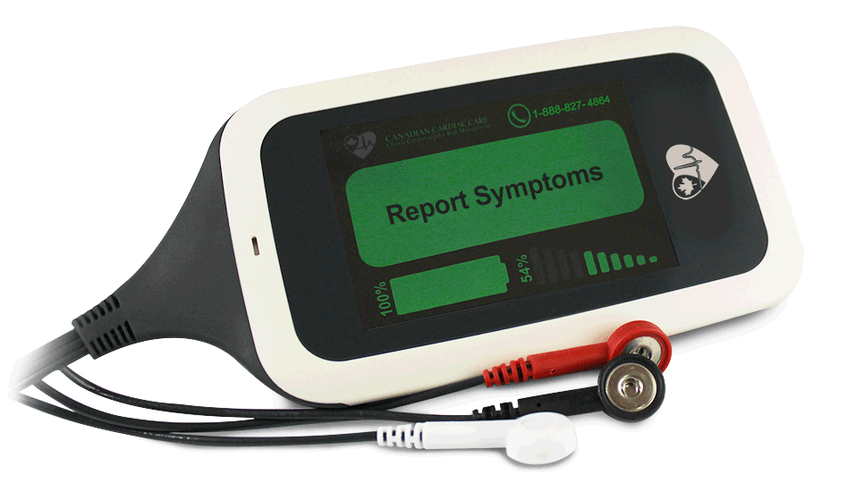
MCOT(mobile cardiac outpatient telemetry)—real time transmission of arrythmic events, for early intervention
1—4 wks
Full disclosure

Slide 18
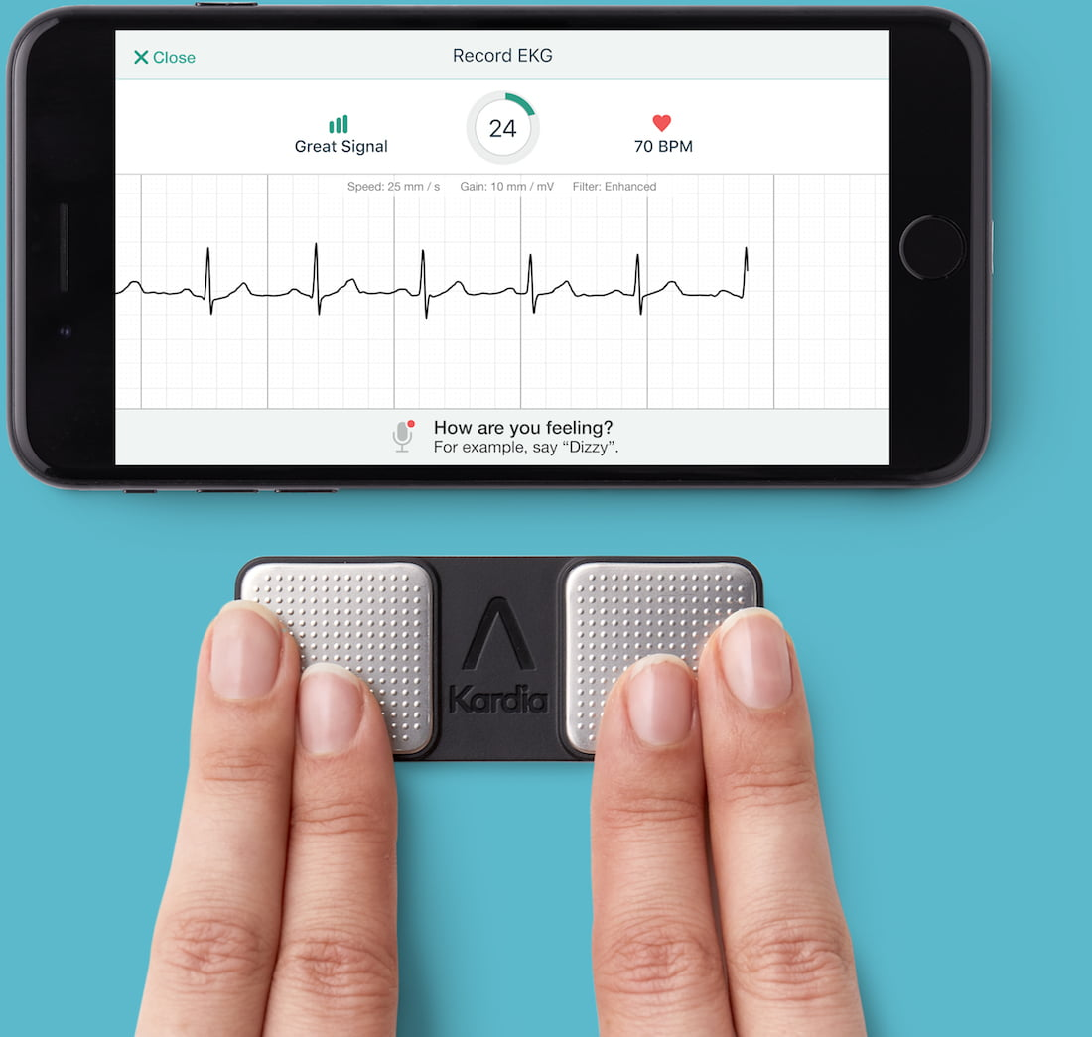
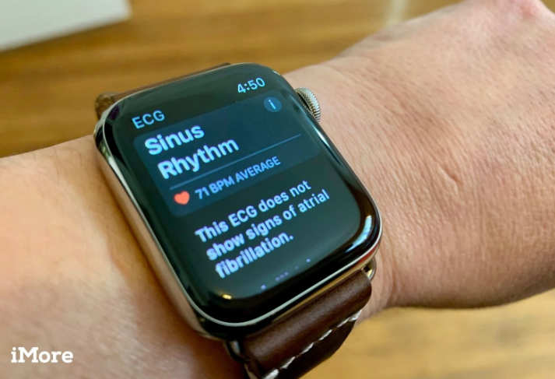
KardiaMobile –electrodes attached to mobile—iphone—fingers placed across electrodes—records
I watch

Slide 21
Indications
Diagnosis
Unexplained palpitations
Unexplained syncope
Atypical chest pain/post MI patients—risk stratification
Cryptogenic stroke
PM malfunction
Prognosis
HCM
ARVC
WPW
Arrythmia treatment assessment
Evaluation of antiarrythmic drug therapy
Post ablation

Slide 22
Selection of appropriate technology
Diagnostic power
Symptom frequency
Cost effectiveness
Local availability
Overall patient condition

Slide 23
Backward memory—data captured before patient activation
Full disclosure—data from entire recording period
Multichannel –records signals from 2 or more leads simultaneously
Post event monitor—recording activated by patient when an event occurs
Telemetry transmission—continuously transmits data to remote monitoring station
Wearable device—incorporated into device which can be easily worn

Slide 24
Patient preparation
Prepare skin
Proper preparation of the areas of the chest—for electrode attachment
Always wear the monitor
Keep it turned on 24 hrs
Do not get any part wet
Record activities in a diary—movement recording, time of medications
Avoid of interference
Magnets,microwaves,cell phones

Slide 25
Interpretation of results
Affirmative
Exclusive
Presumptous

Slide 26
Data interpretation
Frequency trend
Expresses the nycthermal profile of 24 hr period
Average frequency indicates acceleration during daily activities and slowing down during sleep, reflecting neurohormonal activity

Slide 27
Hourly expressions
Expressed in average,minimal and maximal HR frequency—add great deal of information
Monitored values must be corelated with activities
Always rule out non cardiac cause—causing brady or tachycardia

Slide 30
Reporting
Quantitative and qualitative information
Arrythmic episodes—VE/SVE, total number,runs,couplets or salvos,NSVT, bi/trigeminy
Pauses—duration,total number
Ischemic episodes—ST changes; BOTH ST elevation and depression, poor prognosis

Slide 31
Lown grading of VPC
Grade 0—No VPC
Grade 1—Infrequent VPC
Grade 2—Frequent VPC
Grade 3—Multifocal VPC
Grade IVa—Couplets
Grade IVb—Triplets or NSVT
Grade V—R on T phenomenon

Slide 34
Heart rate variability
Objective metric of a measure of the autonomic system
Variance in time between the heart beats
60bpm—0.9s between one between one and 1.15s between the other;this variability is HRV
Cycle length variability/RR (NN)variability/heart period variability
At rest—high HRV is favourable and in active state the vice versa

Slide 35
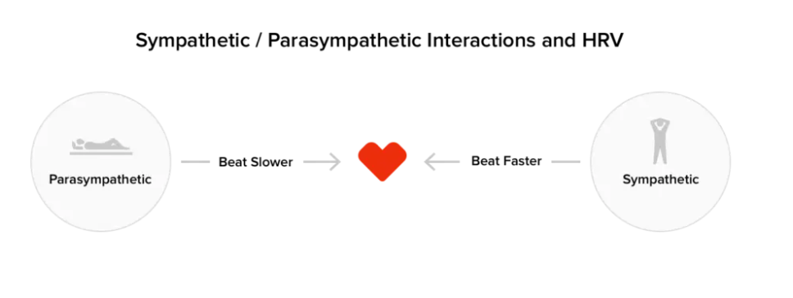
Although HRV manifests as function of HR, it complex interplay between neural, cardiac and respiratory system
Symphathetic and parasymphathetic
At rest—high HRV is favourable and in active state the vice versa
Indicates overall vagal tone of heart

Slide 37
Time domain Frequency domain Non linear metrics

Slide 38
Frequency domain analysis better than time domain
VLF , LF and HF domains
HF domain—indicates vagal tone response, respiratory rate between 9—24 cycles/min included; ratio of LF/HF—marker of HRV
HRV predicts all cause mortality,LVEF and NSVT after MI and DCM

Slide 39
Heart rate turbulence
Index of change in sinus discharge rate after PVC
Normally sinus rate accelerates then slows, this phenomenon blunted in many heart diseases
Indicates reflex vagal response of heart
Abnormal response—predictor of mortality in pts with CAD and DCM

Slide 40
QRS,QT dispersion and T wave
Heterogeinity in refractoriness and conduction velocity—hallmark of reentrant arrythmias
Conduction heterogeinity—QRS duration(including fragmented QRS)
Refractoriness heterogeinity—QT interval
Dispersion—max and min QT interval
Values—30 and 60ms—normal
T peak to end—>90ms—3 fold increase in SCD
T wave alternans

Slide 41
Arrythmias NOT SIGNIFICANT
Sinus bradycardia during rest or sleep
Sinus arrythmias
Sino atrial block
Wenkebach block
Wandering atrial pacemaker
Junctional escape complex
Prematrure PAC or PVC

Slide 42
SIGNIFICANT
Frequent atrial ,nodal & ventricular rhythm( >30/hr or >15% of total)
Bigeminy, couplets or salvos
Type 2 second degree AV block/3rd HB
Pause>2.5 s
Marked bradycardia during waking hours
Tachyarrythmias(atrial,nodal &ventricular)
ST shift ≥1mm

Slide 43
Post MI pts—occurrence of more than 10 VPC/hr and NSVT—associated with 1.5 –2 fold increase in death independent of LV function
CAST—PVC’s identified pts at increased risk for SCD, but successful treatment with drugs(flecainide, encainide or moricizine)—increased mortality
ST depression of 1mm for 30 seconds—corelates with myocardial ischemia

Slide 47
Thank you..

